Slide 1
UNIVERSITY INSTITUTE OF COMPUTING Bachelor of Computer Application Subject Name: Data Structure 24CAP-151/24SCT-151

Slide 2
VISION
To be a Centre of Excellence for nurturing computer professionals with strong application expertise through experiential learning and research for matching the requirements of industry and society instilling in them the spirit of innovation and entrepreneurship.

Slide 3
Mission of the Department
M1. To provide innovative learning centric facilities and quality-oriented teaching learning process for solving computational problems.
M2. To provide a frame work through Project Based Learning to support society and industry in promoting a multidisciplinary activity.
M3. To develop crystal clear evaluation system and experiential learning mechanism aligned with futuristic technologies and industry.
M4. To provide doorway for promoting research, innovation and entrepreneurship skills incollaboration with industry and academia.
M5. To undertake societal activities for upliftment of rural/deprived sections of the society.

Slide 4
Program Outcomes
PO1 Apply mathematics and computing fundamental and domain concepts to find out the solution of defined problems and requirements. (Computational Knowledge)
PO2 Use fundamental principle of Mathematics and Computing to identify, formulate research literature for solving complex problems, reaching appropriate solutions. (Problem Analysis)
PO3 Understand to design, analyze and develop solutions and evaluate system components or processes to meet specific need for local, regional and global public health, societal, cultural, and environmental systems.
PO4 (Design /Development of Solutions)Use expertise research-based knowledge and methods including skills for analysis and development of information to reach valid conclusions. (Conduct Investigations of Complex Computing Problems)
PO5 Adapt, apply appropriate modern computing tools and techniques to solve computing activities keeping in view the limitations. (Modern Tool Usage)
PO6 Exhibiting ethics for regulations, responsibilities and norms in professional computing practices. (Professional Ethics)
PO7 Enlighten knowledge to enhance understanding and building research, strategies in independent learning for continual development as computer applications professional. (Life-long Learning)
PO8 Establishing strategies in developing and implementing ideas in multi- disciplinary environments using computing and management skills as a member or leader in a team. (Project Management and Finance)
PO9 Contribute to progressive community and society in comprehending computing activities by writing effective reports, designing documentation, making effective presentation, and understand instructions. (Communication Efficacy)
PO10 Apply mathematics and computing knowledge to access and solve issues relating to health, safety, societal, environmental, legal, and cultural issues within local, regional and global context. (Societal and Environmental Concern)
PO11 Gain confidence for self and continuous learning to improve knowledge and competence as a member or leader of a team. (Individual and Teamwork)
PO12 Learn to innovate, design and develop solutions for solving real life business problems and addressing business development issues with a passion for quality competency and holistic approach. (Innovation and Entrepreneurship)

Slide 5
Program Educational Objectives
PEO1 Demonstrate analytical and design skills including the ability to generate creative solutions and foster team-oriented professionalism through effective communication in their careers.
PEO2 Expertise in successful careers based on their understanding of formal and practical methods of application development using the concept of computer programming languages and design principles in accordance to industry 4.0
PEO3 Exhibit the growth of the nation and society by implementing and acquiring knowledge of upliftment of health, safety and other societal issues.
PEO4 Implement their exhibiting critical thinking and problem- solving skills in professional practices or tackle social, technical and business challenges.

Slide 6
Program Specific Outcomes
PSO1 Analyze their abilities in systematic planning, developing, testing and executing complex computing applications in field of Social-Media and Analytics, Web Application Development and Data Interpretations.
PSO2 Apprise in-depth expertise and sustainable learning that contributes to multi-disciplinary creativity, permutation, modernization and study to address global interest.

Slide 7
Contents
Course Objectives
Course Outcomes
Program Outcomes
Syllabus
Introduction to Data Structure
Importance of Data Structure
Need of Data Structure
Applications

Slide 8
Course Description
Data Structures is a course that focuses on the study of various data structures and algorithms used in computer science.
The course covers the theoretical foundations of data structures, as well as practical techniques for implementing and manipulating them.
In this course, students will learn about the basic concepts of data structures, including arrays, linked lists, stacks, queues, trees, and graphs.

Slide 9
Course Objectives
CO1
To access how the choices of data structure & algorithm methods impact the performance of program
CO2
To Solve problems based upon different data structure & also write programs
CO3
Choose an appropriate data structure for a particular problem.
To efficiently implement the different data structures.
CO4

Slide 10
Course Outcomes
CO1
Infer the knowledge of basic data structures and their implementations
CO2
Ascertain the strength and weakness of different data structures
CO3
Figure out the algorithmic complexity of simple, non-recursive programs
CO4
CO5
Develop novel solutions to small scale programming challenges involving data structures and recursion
Select sensibly appropriate data structures and algorithms for problems and to justify that choice

Slide 11
Program Outcomes
PO1 Apply mathematics and computing fundamental and domain concepts to find out the solution of defined problems and requirements. (Computational Knowledge)
PO2 Use fundamental principle of Mathematics and Computing to identify, formulate research literature for solving complex problems, reaching appropriate solutions. (Problem Analysis)
PO3 Understand to design, analyze and develop solutions and evaluate system components or processes to meet specific need for local, regional and global public health, societal, cultural, and environmental systems.
PO4 (Design /Development of Solutions)Use expertise research-based knowledge and methods including skills for analysis and development of information to reach valid conclusions. (Conduct Investigations of Complex Computing Problems)
PO5 Adapt, apply appropriate modern computing tools and techniques to solve computing activities keeping in view the limitations. (Modern Tool Usage)
PO6 Exhibiting ethics for regulations, responsibilities and norms in professional computing practices. (Professional Ethics)
PO7 Enlighten knowledge to enhance understanding and building research, strategies in independent learning for continual development as computer applications professional. (Life-long Learning)
PO8 Establishing strategies in developing and implementing ideas in multi- disciplinary environments using computing and management skills as a member or leader in a team. (Project Management and Finance)
PO9 Contribute to progressive community and society in comprehending computing activities by writing effective reports, designing documentation, making effective presentation, and understand instructions. (Communication Efficacy)
PO10 Apply mathematics and computing knowledge to access and solve issues relating to health, safety, societal, environmental, legal, and cultural issues within local, regional and global context. (Societal and Environmental Concern)
PO11 Gain confidence for self and continuous learning to improve knowledge and competence as a member or leader of a team. (Individual and Teamwork)
PO12 Learn to innovate, design and develop solutions for solving real life business problems and addressing business development issues with a passion for quality competency and holistic approach. (Innovation and Entrepreneurship)

Slide 12
Syllabus
Unit-1 | Introduction, Arrays and Structures
Introduction | Pointers and Dynamic memory allocation, Types of data structures, Mathematical notation and functions, Algorithm Analysis: Space Complexity, Time Complexity, Asymptotic Notation and Algorithmic complexity, Abstract Data Type.
Array | Array Introduction, Types, Applications, Operation on an array
Searching and Sorting | Linear Search, Binary Search (Recursive and iterative, Evaluation of Polynomial, Polynomial representation, Bubble sort, Selection sort, Insertion sort, Quick Sort and Merge Sort.
Structure | Internal representation of structure, Self –referential structure, types of self-referential structures.

Slide 13
Syllabus
Unit-2 | Stack, Queue and Linked List
Linked List | Representation of linked list, linked list operations (Create, Insertion, Printing, Deleting and Traversing), Circular Linked List, doubly linked list and Header Linked List.
Stack | Introduction & Primitive operations on stack, memory Representation of Stack via arrays and Linked List, Stack Operations, Application of Stack , Evaluation of Expression: Evaluation of Postfix expression, Infix to Postfix and prefix forms for expressions.
Queue | Introduction & Primitive Operations on Queue, Representation using array and linked List, Queue Operations, Types of queues, Applications of queue.

Slide 14
Syllabus
Unit-3 | Trees, Graphs and Sorting
Trees | Definition, Terminology, Representation, Binary tree: Introduction, Representation of Binary Tree and its types, Traversal (In-order, Pre-order, Post-order). Binary Search Tree, Heap Tree and its Types, AVL/Height Balanced Tree
Graphs | Representation of Graphs, Adjacency Matrix and List, In degree, out degree of graph, Depth First Search and Breath First Search

Slide 15
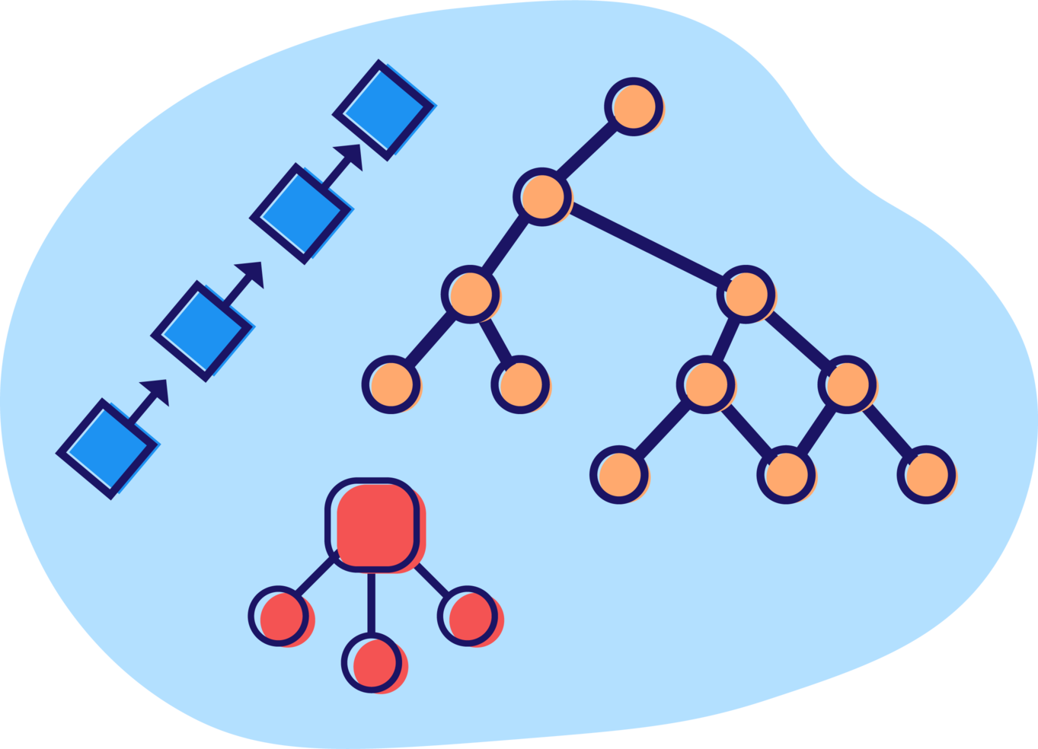
Data Structure Introduction
Data structure is a particular way of organizing data in a computer so that it can be used effectively.
An efficient data structure also uses minimum memory space and execution time to process the structure.
A data structure is not only used for organizing the data. It is also used for processing, retrieving, and storing data.
There are different basic and advanced types of data structures that are used in almost every program or software system that has been developed. Eg- Arrays, Trees, Graphs, Linked List etc.

Slide 16
Importance of Data Structure
Problem-Solving
Efficient Algorithms
Memory Management
The choice of data structure can greatly influence the efficiency and performance of algorithms, leading to faster and more scalable solutions.
Data structures help optimize memory usage by storing and retrieving data in an organized manner, reducing waste and improving overall system performance.
Data structures provide the tools and techniques to solve complex problems by organizing and managing data effectively.

Slide 17
Need Of data Structure
Easy way of organizing, retrieving, managing, and storing data.
Requires less time
Save storage memory space
Data representation is easy
Easy access to the large database
Modification of Data is easy

Slide 18





Applications of Data Structures
Databases
Operating Systems
Efficient storage and retrieval of data.
Managing memory, files, and processes.
Algorithms
Compilers
Designing efficient solutions to problems.
Parsing and translating programming languages.

Slide 19
Book References
TEXT BOOKS
Seymour Lipchitz, Schaum's Outlines Series Data Structures TMH. J.P. Hayes, Computer Organization and Architecture, Third Edition, TMH.
Data Structure Theory Problem and Algorithms, R.S. Salaria, Khanna Book Publishing Company, Delhi.
REFERENCE BOOKS
Introduction to Data Structures Applications, Trembley&Soreson, Second Edition, Pearson Education Robert L. Britton, MIPS Assembly Language Programming, Pearson Prentice Hall.
A. Tanenbaum, Y. Lanhgsam and A. J. Augenstein, Data Structures Using C++, Prentice Hall of India, 1990

Slide 20
Video Links
Introduction to Data Structures

Slide 21
THANK YOU
Created by: Mehak Bhatia (E16757)
mehak.e16757@cumail.in

